Slide 1
why web components?
@mikegeyser
31 January 2020

Slide 2


Sorry!

Slide 3

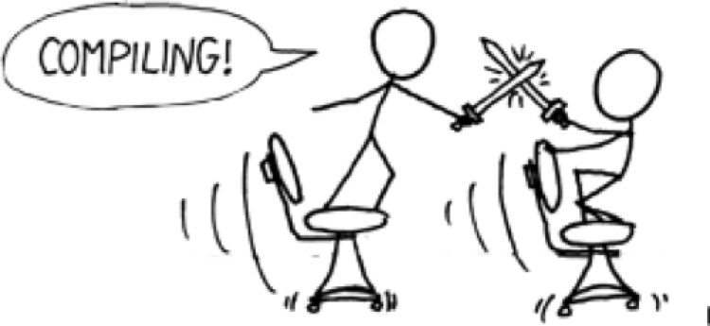

Slide 4


Slide 5
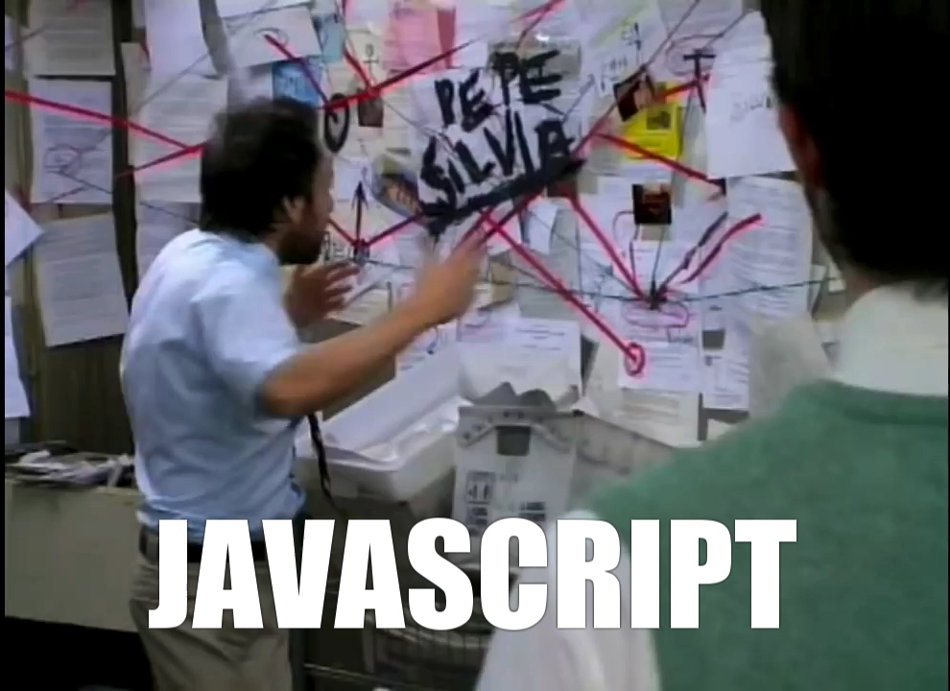

Slide 6




ES5
ES6
ES2015
ES2016
ES2017
ES2018

Slide 7
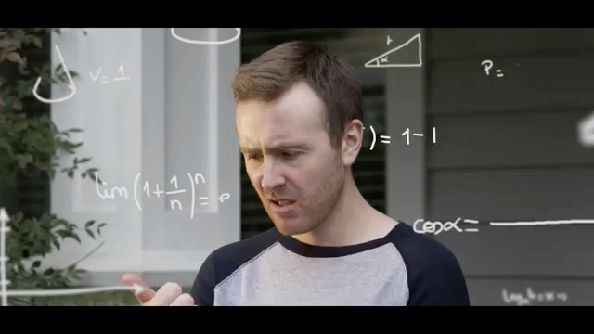

Slide 8
ES2015+
Web Components
+
🔥

Slide 9
web components
Web Standards
-> Customiseable
-> Reuseable
-> Encapsulated
Built-in APIs
-> Custom Elements API
-> Shadow DOM

Slide 10
what we’ll use
es-dev-server
-> Bare module imports
lit-html
-> Template rendering
LitElement
-> Change detection

Slide 11

JAVASCRIPT

Slide 12

DEMO TIME

Slide 13
in summary
It can (and should) be easier.
It doesn’t *have* to be this (it just works for me).
Keep it simple. Use the platform.

Slide 14
questions?
@mikegeyser
mikerambl.es/videos
lit-html.polymer-project.org

